Slide 1
Number Systems and Arithmetic

Slide 2

Introduction
In this lesson, we will study basic arithmetic operations in various number systems with a particular stress on the binary system.
we understand how to convert between binary and decimal numbers.
we are going to learn how to perform addition, subtraction, multiplication, and division with binary numbers.
So let’s ready for that

Slide 3
Binary Numbers
It needs to represent only two states,On and Off.
A transistor circuit that is either on or off has two possible signal values and can be constructed to be extremely reliable.
A decimal number (5740.750)₁₀ can be represented as follows
5*10³ +7*10² +4*10¹+0*10⁰+7*10⁻¹+5*10⁻²
In general a number with decimal point is represented by a series of coefficients as follows:
a₃a₂a₁a_{0 .}a₋₁a₋₂a₋₃
Hence the actual number can be written as
10³*a₃ +10²*a₂+10¹*a₁+10⁰*a₀+10⁻¹*a₋₁+10⁻²*a₋₂+10⁻³*a₋₃

Slide 4
Binary Numbers
The coefficient of binary system has two possible values 0 and 1.
Each coefficient a_{k} is multiplied by 2^{k} . So (11101.11)₂ can be represented as
1*2⁴+1*2³+1*2²+0*2¹+1*2⁰+1*2⁻¹+1*2^{‑2} = (29.75)₁₀
In general a number expressed in base-r system has coefficients multiplied by power of r
a_{n}*r^{n}+ a_{n-1}*r^{n-1}+a_{n-2}*r^{n-2}+a_{n-3}*r^{n-3}+……….++a₁*r¹+a₀+a₋₁*r⁻¹++a₋₂*r⁻²+….+ a_{-m}*r^{-m}
Convert (403.5)₅ to decimal
4*5²+0*5¹+3*5⁰+5*5⁻¹= (104)₁₀
## Work for (4021.2)₅=(511.4)₁₀

Slide 5
HexaDecimal Numbers
For Hexa decimal system (base 16), first ten digits are borrowed from decimal system.
and letters A, B, C,D,E and F are used for digits 10,11,12,13,14 and 15 respectively.
An example of hexadecimal system is
(C5F2.E1)₁₆=12*16³+5*16²+15*16¹+2*16⁰+14*16⁻¹+1*16⁻²=(50674.9375)₁₀
## work for (B65F)₁₆=(46687)₁₀

Slide 6


Octal and Hexadecimal Numbers
Since 2³ =8 and 2⁴=16, each octal digits corresponds to three binary digits and each hexadecimal digit corresponds to four binary digits.
Conversion from Binary to Octal
Conversion from Binary to Hexadecimal

Slide 7
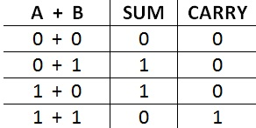
Binary Addition
We need to learn four basic rules in order to perform binary addition.
These rules are listed in the table below.

Slide 8
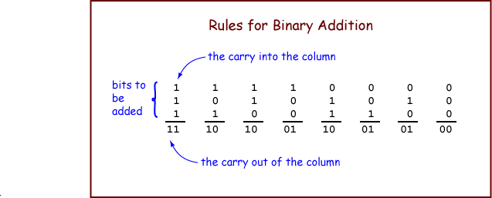
Binary Addition
Another tricks.

Slide 9
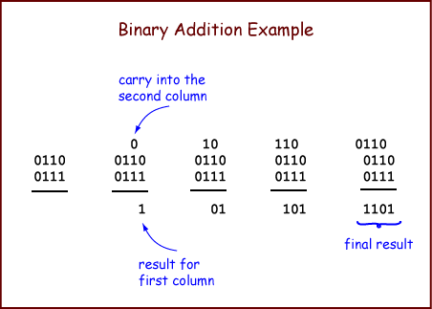
Binary Addition
Example

Slide 10
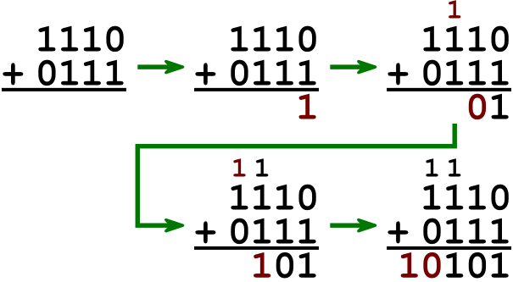
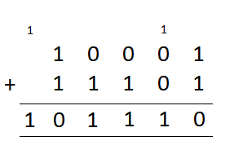
Binary Addition
Example

Slide 11
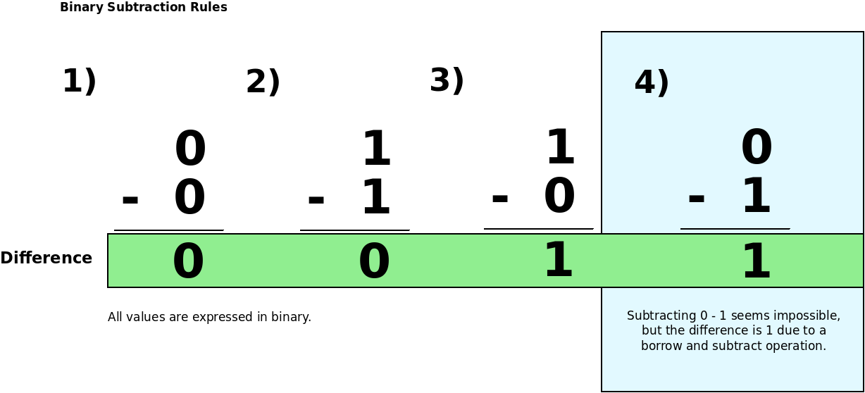
Binary Subtraction
We need to learn four basic rules in order to perform binary subtraction.
These rules are listed in the table below.

Slide 12
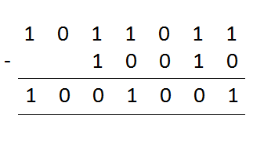
Binary Subtraction
Example

Slide 13
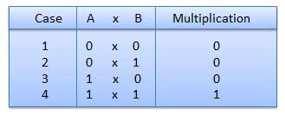
Binary Multiplication
Binary multiplication is similar to decimal multiplication. It is simpler than decimal multiplication because only 0s and 1s are involved.
There are four rules of the binary multiplication.

Slide 14
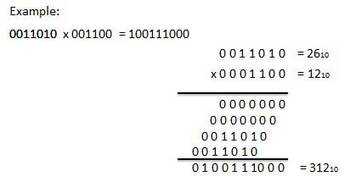
Binary Multiplication

Slide 15
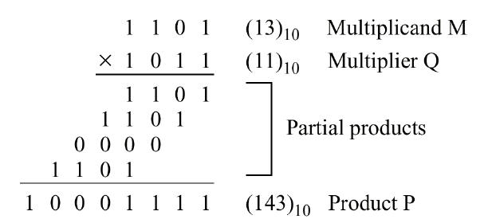
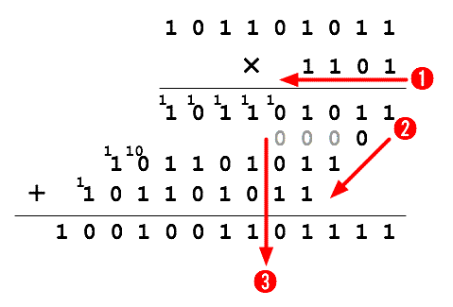
Binary Multiplication

Slide 16
Binary Division
Binary division is similar to decimal division.
It is called as the long division procedure.

Slide 17
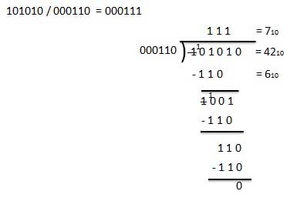
Binary Division

Slide 18
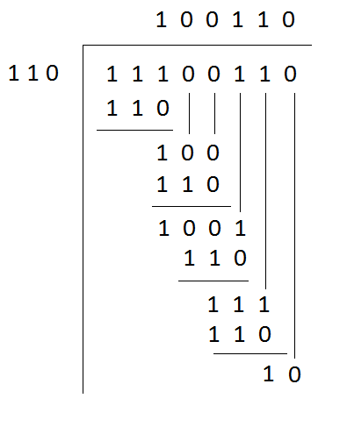
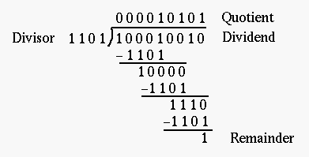
Binary Division

Slide 19
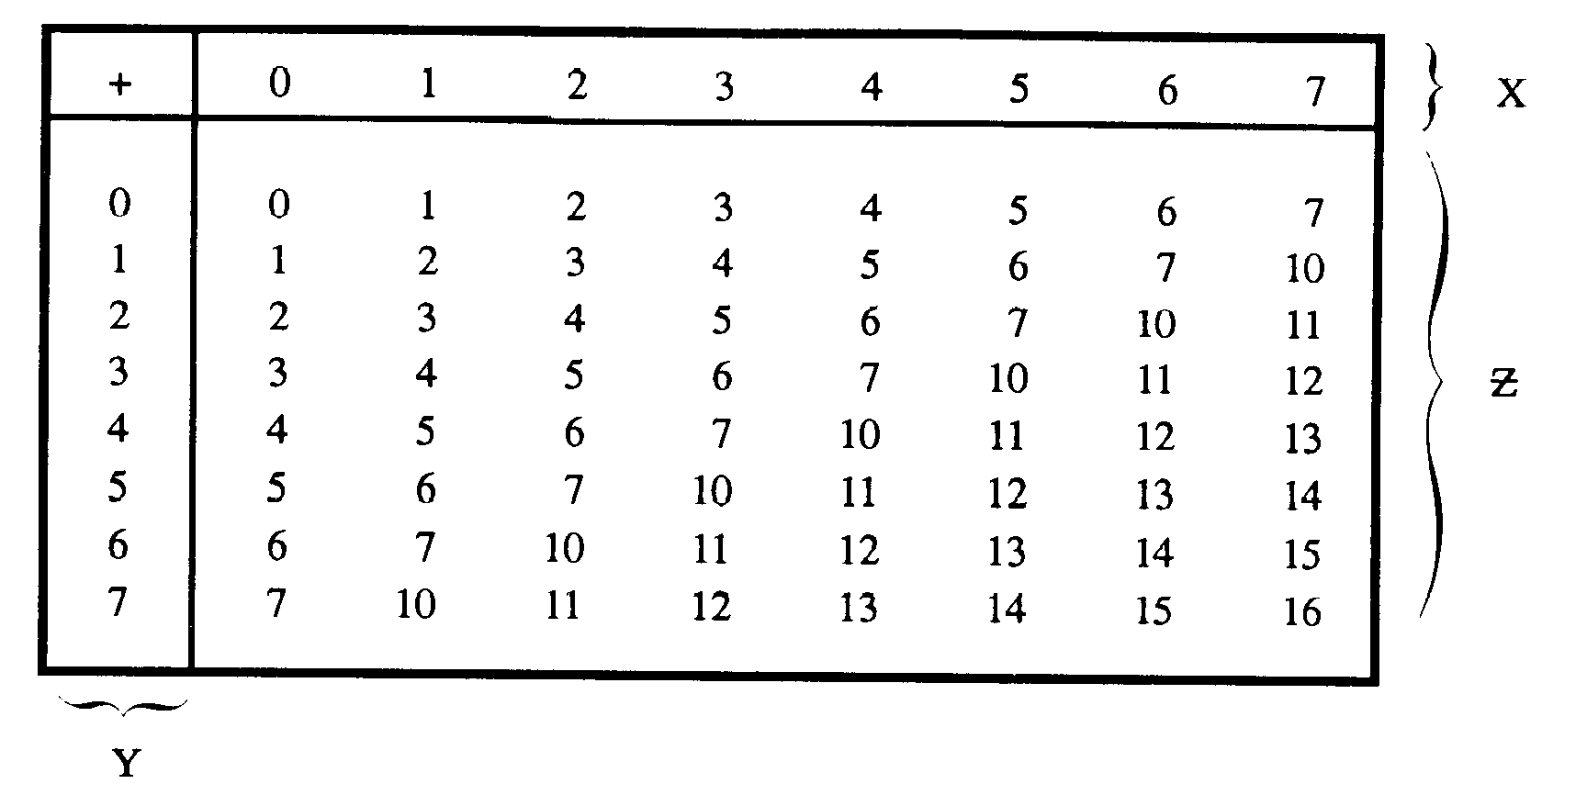
Octal Addition
Following octal addition table will help you greatly to handle Octal addition.

Slide 20
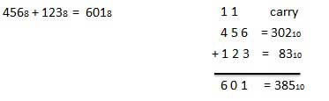
Octal Addition
Example

Slide 21
Octal Subtraction
The subtraction of octal numbers follows the same rules as the subtraction of numbers in any other number system.
The only variation is in borrowed number.
In the decimal system, you borrow a group of 10₁₀.
In the binary system, you borrow a group of 2₁₀.
In the octal system you borrow a group of 8₁₀.

Slide 22
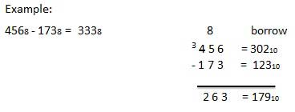
Octal Subtraction
Example

Slide 23
Octal Multiplication and Division
Similar to binary multiplication and division.
Self study

Slide 24
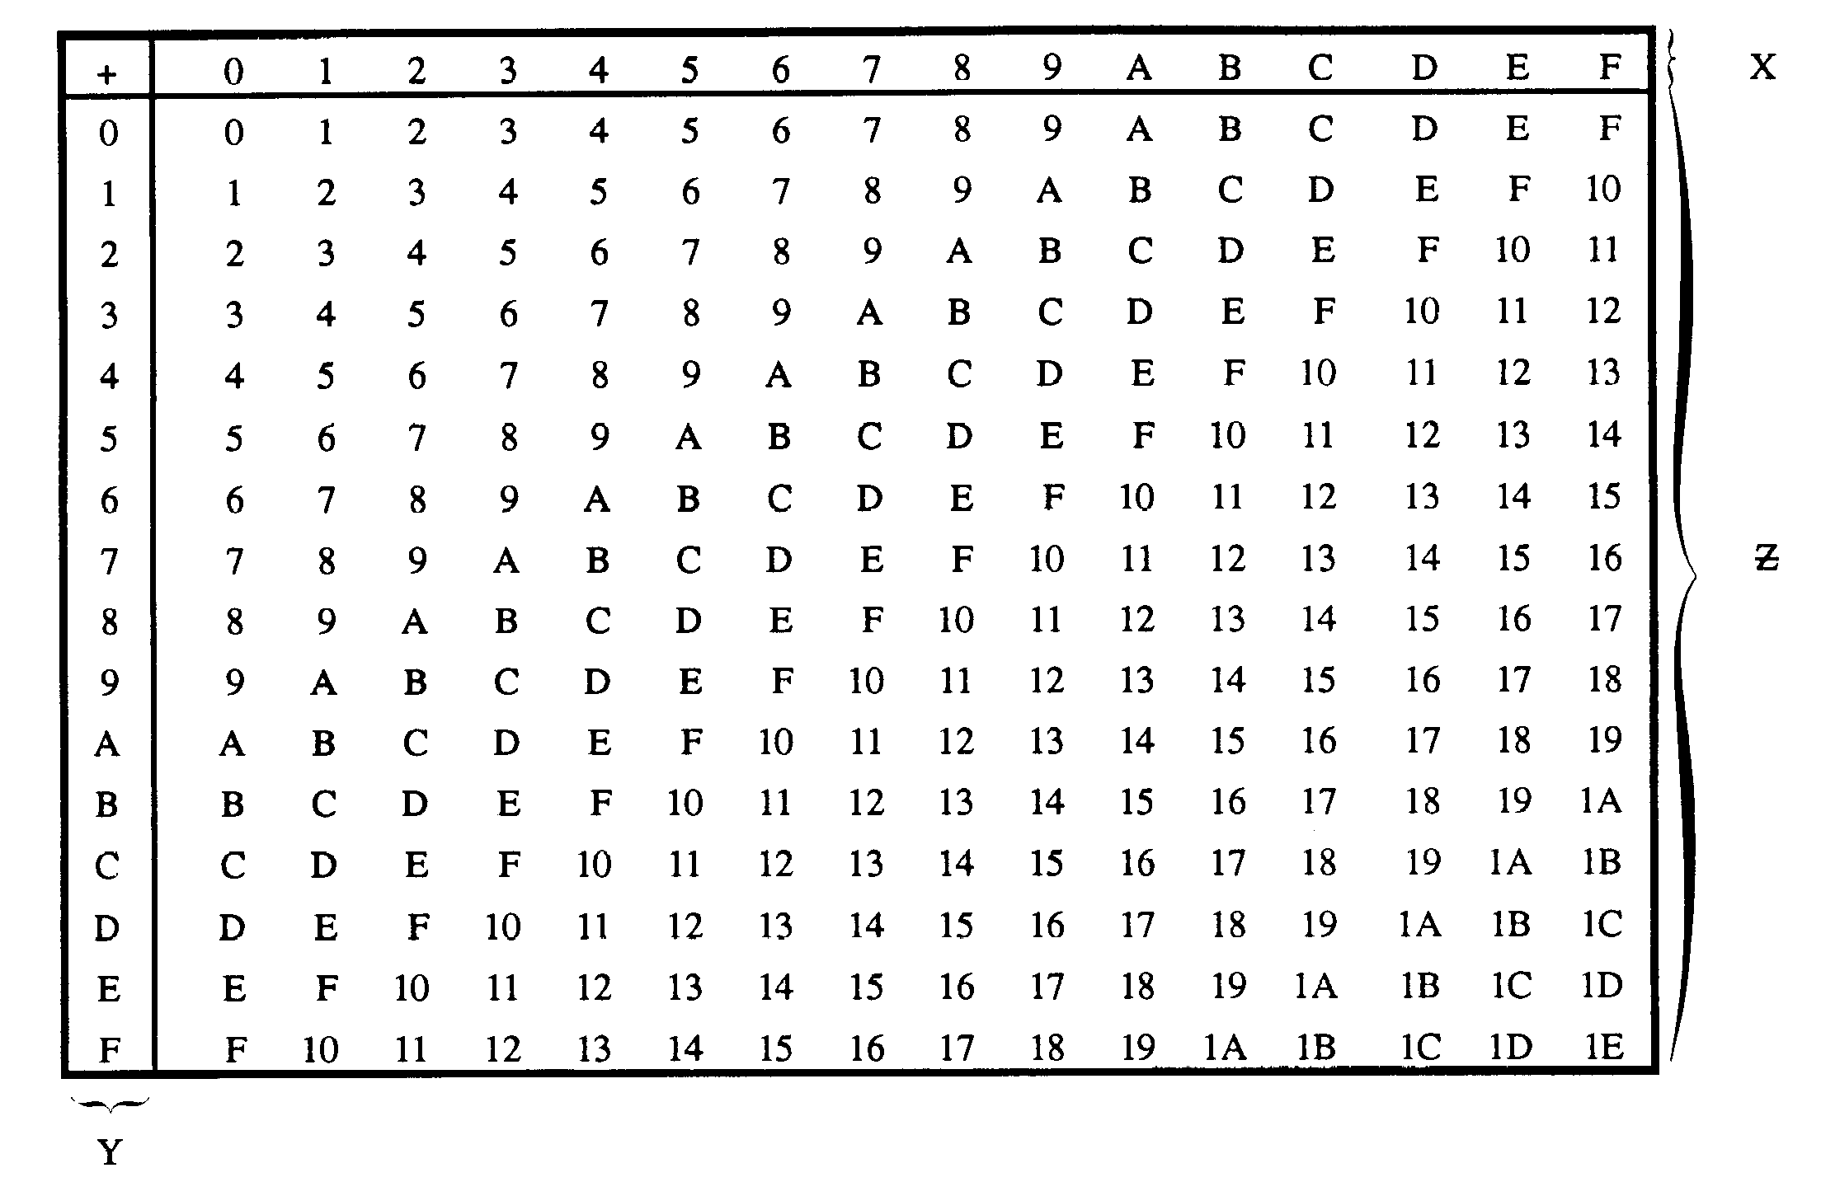
Hexadecimal Addition
Following hexadecimal addition table will help you greatly to handle Hexadecimal addition.

Slide 25
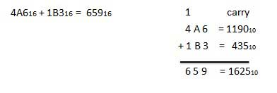
Hexadecimal Addition
Example

Slide 26
Hexadecimal Subtraction
The subtraction of hexadecimal numbers follows the same rules as the subtraction of numbers in any other number system.
The only variation is in borrowed number.
In the decimal system, you borrow a group of 10₁₀.
In the binary system, you borrow a group of 2₁₀.
In the hexadecimal system you borrow a group of 16₁₀.

Slide 27
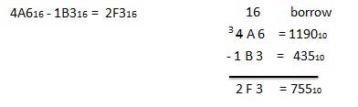
Hexadecimal Subtraction
Example

Slide 28
Hexadecimal Multiplication and Division
Similar to binary multiplication and division.
Self study

Slide 29

Any question?

Slide 30

Complete Number System Arithmetic

